Slide 1



Welcome you all
Course: CSS
Day 5 (Session 1)
LIST
R.Surekha
Technical Trainer,
KG Micro College
KGiSL Campus, Coimbatore – 641 035.

Slide 2
list-style-type
Definition
The list-style-type specifies the type of list-item marker in a list.
list-style-type: This property is responsible for controlling the appearance and shape of the marker.
The list-style-type CSS property sets the marker (such as a disc, character, or custom counter style) of a list item element.
You can use this property on the <ol> or <ul> element to set the marker for all list items, or on the <li> element to set the marker for a specific list item.

Slide 3
The color of the marker will be the same as the computed color of the element it applies to.
Only a few elements (<li> and <summary>) have a default value of display: list-item. However, the list-style-type property may be applied to any element whose display value is set to list-item. Moreover, because this property is inherited, it can be set on a parent element (commonly <ol> or <ul>) to make it apply to all list items.
Example:
ul {
list-style-type: square;
}
This will make all unordered list items be square bullets.
Example:
ol li{
list-style-type: upper-alpha;
}
This will make all list items of ordered list will be upper-alpha i.e A,B,C etc.

Slide 4
The list-style-type CSS property sets the marker (bullet or number) for a list item. The property can be set for an ordered list (with numbers or letters) or an unordered list (with bullets or other symbols).
The possible values for list-style-type include:
disc: a filled circle
circle: an empty circle
square: a square
decimal: decimal numbers (1, 2, 3, etc.)
lower-roman: lowercase Roman numerals (i, ii, iii, etc.)
upper-roman: uppercase Roman numerals (I, II, III, etc.)
lower-alpha: lowercase letters (a, b, c, etc.)
upper-alpha: uppercase letters (A, B, C, etc.)
none: no marker
decimal-leading-zero:The marker is a number with leading zeros (01, 02, 03, etc.)

Slide 5
list-style-image
To use an image as the bullet point in a list in CSS, you can use the "list-style-image" property. Here is an example of how to use it:
Example:
ul {
list-style-image: url(“thumbsup.jpeg”);
}
You can also apply this to specific lists by targeting their class or id.
Example:
#own{
list-style-image: url(“smiley.jpeg");
}
.drop{
list-style-image:url(“hand.jpeg”);
}

Slide 6
CSS Syntax
list-style-image:none;
list-style-image:url;
list-style-image:initial;
list-style-image:inherit;
Value | Description
none | No image will be displayed. Instead, the listmarker will be rendered. This is default
url | The path to the image to be used as a list-item marker
initial | Sets this property to its default value.
inherit | Inherits this property from its parent element.

Slide 7
list-style-position
In CSS, the list-style-position property specifies the position of the marker (bullet point) for list items. It can have one of two values:
inside: the marker is positioned inside the list item's content box.
outside: the marker is positioned outside the list item's content box (the default value).
For example, the following CSS will set the marker position to be inside the list item's content box:
ul {
list-style-position inside;
}
li {
list-style-position: inside;
}
It is important to note that the list-style-position property only affects the position of the marker, not the marker itself. To change the marker type, use the list-style-type property.

Slide 8
list-style-position: outside;
means that the bullet points will be outside the list item. The start of each line of a list item will be aligned vertically.
list-style-position: inside;
means that the bullet points will be inside the list item. As it is part of the list item, it will be part of the text and push the text at the start.

Slide 9
POSITION
Value | Description
inside | The bullet points will be inside the list item
outside | The bullet points will be outside the list item. This is default
initial | Sets this property to its default value.
inherit | Inherits this property from its parent element.

Slide 10

There are many properties for setting a background-image.

Slide 11
CSS Background
Setting Background Properties
Background plays an important role in the visual presentation of a web page.
CSS provide several properties for styling the background of an element, including coloring the background, placing images in the background and managing their positioning, etc.
The background properties are background-color, background-image, background-repeat, background-attachment and background-position.
In the following section we will discuss each of these properties in more detail.

Slide 12

background-image:url(“nature.jpeg”);

Slide 13
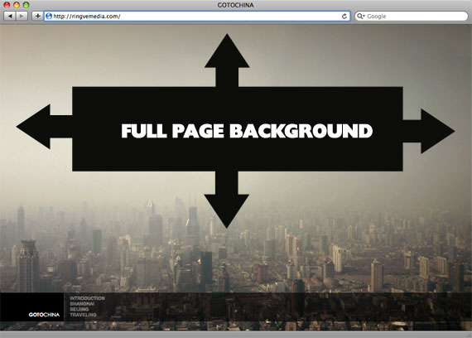

Slide 14
In CSS, the "background-image" property is used to set a background image for an HTML element. The value of the property is the URL of the image file. For example, if you have an image file called "bg.jpg" in the same directory as your HTML file, you can set it as the background image of the "body" element like this:
body {
background-image: url("bg.jpg");
}

Slide 15

When the background image is set for the body

Slide 16
Background Repeat
The background-repeat property allows you to control how a background image is repeated or tiled in the background of an element. You can set a background image to repeat vertically (y-axis), horizontally (x-axis), in both directions, or in neither direction.
body {
background-image:url("images/gradient.png");
background-repeat: repeat-x;
}
repeat-x
repeat-y
no-repeat

Slide 17
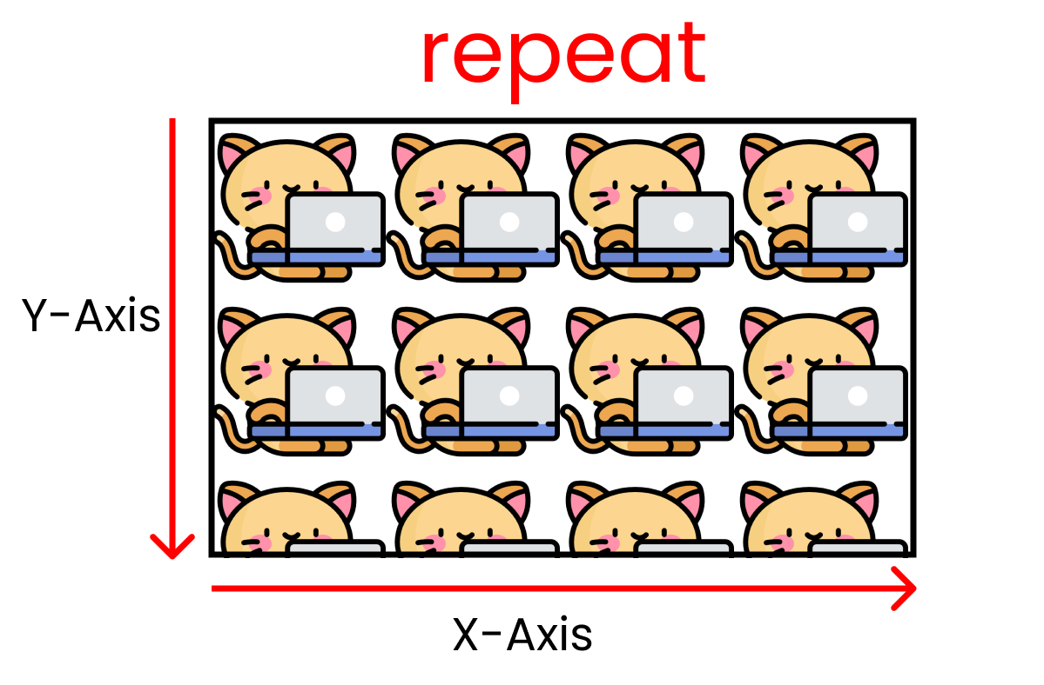
Output of an image when it is repeated

Slide 18
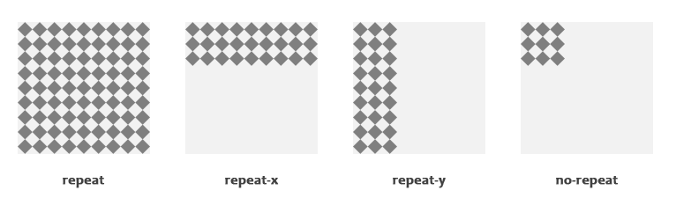

Slide 19
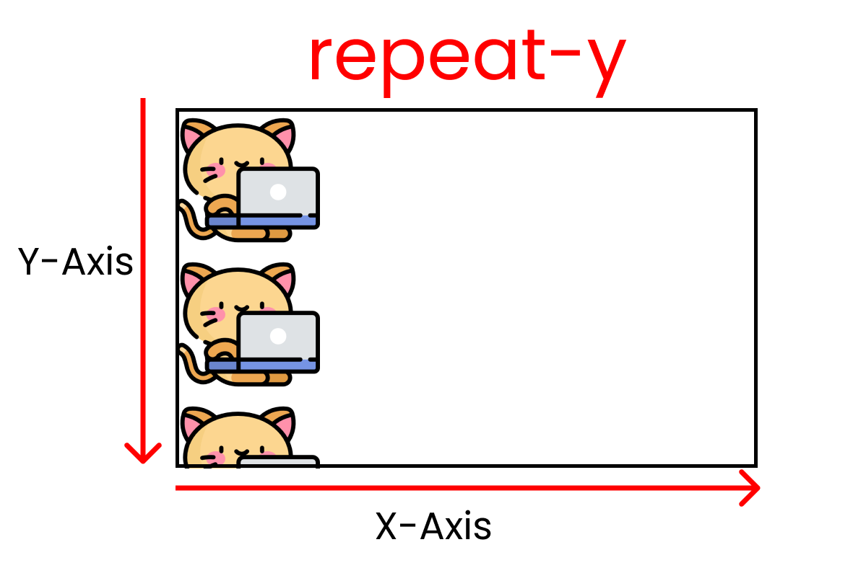
Backgroundimage is repeated along the y-axis

Slide 20
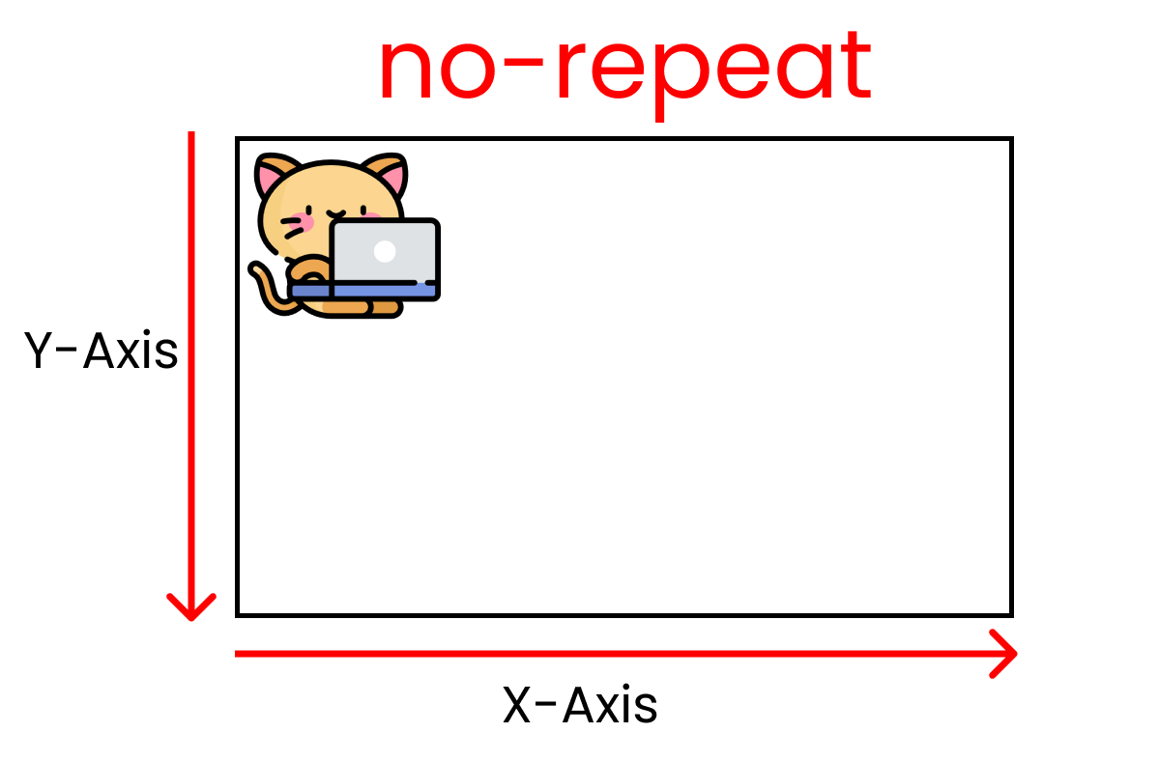
Image is not repeated

Slide 21
Background Position
The background-position property is used to control the position of the background image.
If no background position has been specified, the background image is placed at the default top-left position of the element i.e. at (0,0), let's try out the following example:
body {
background-image: url("images/robot.png");
background-repeat: no-repeat;
background-position: right top;
}

Slide 22


Slide 23
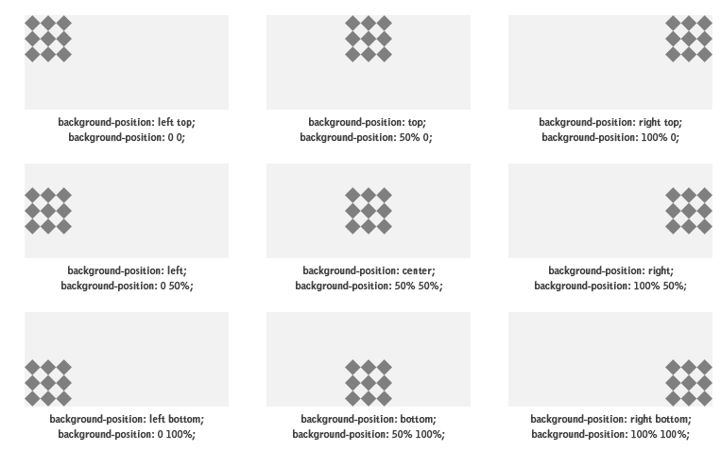

Slide 24
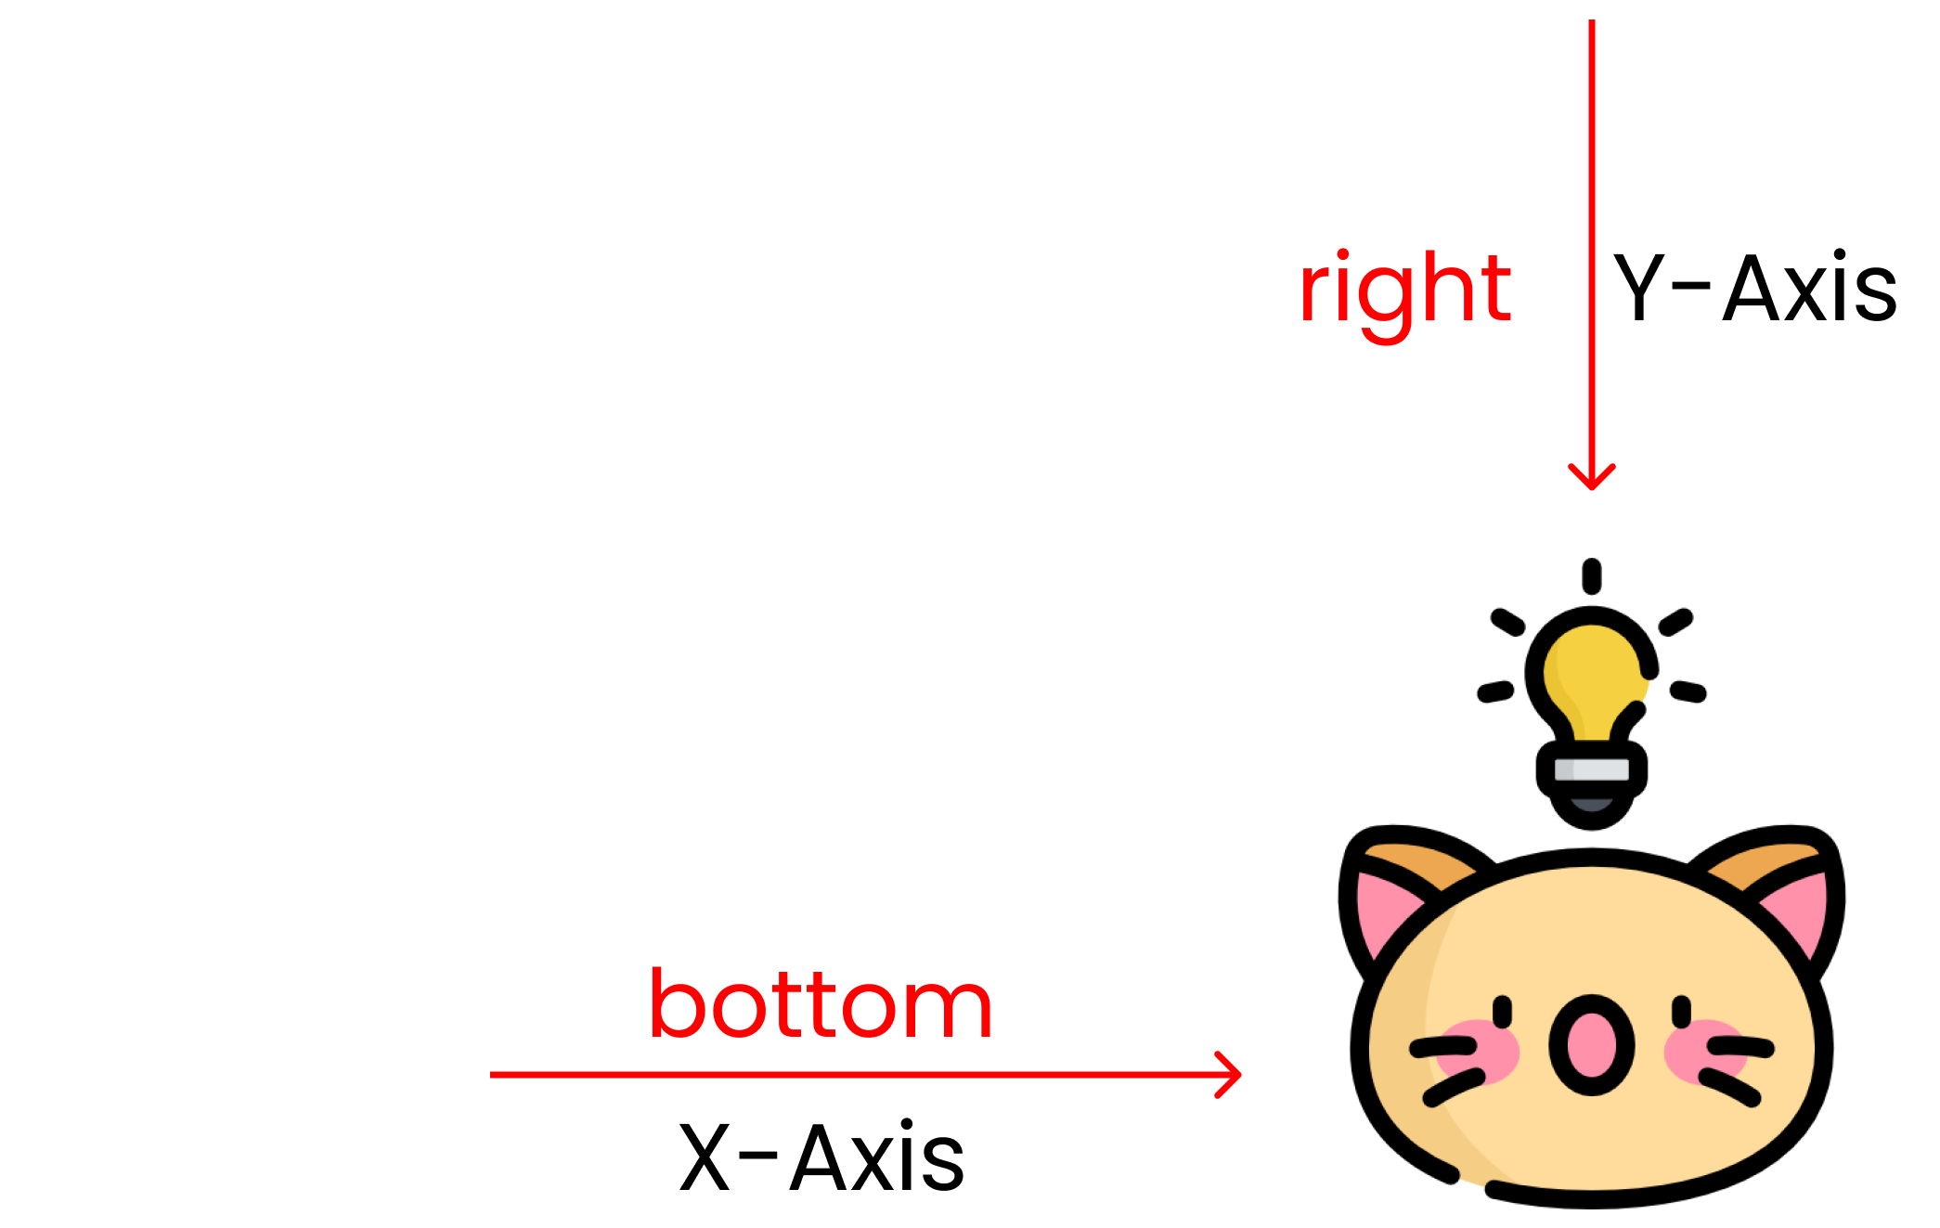

Slide 25
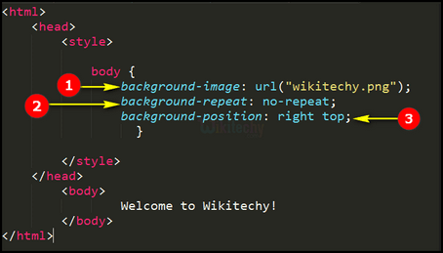

Slide 26
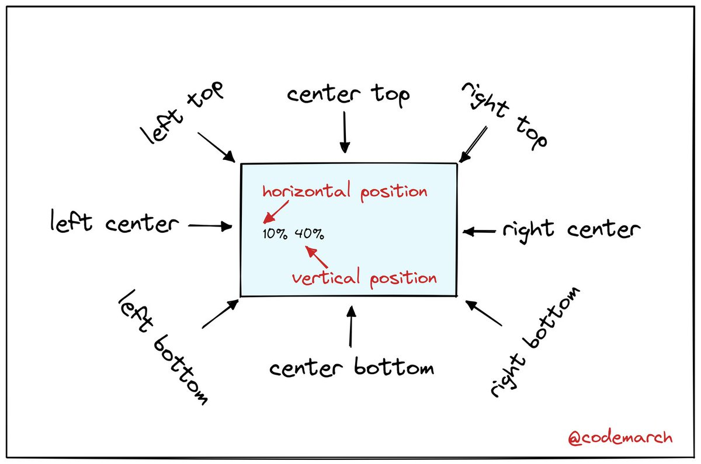
BACKGROUND POSITION

Slide 27
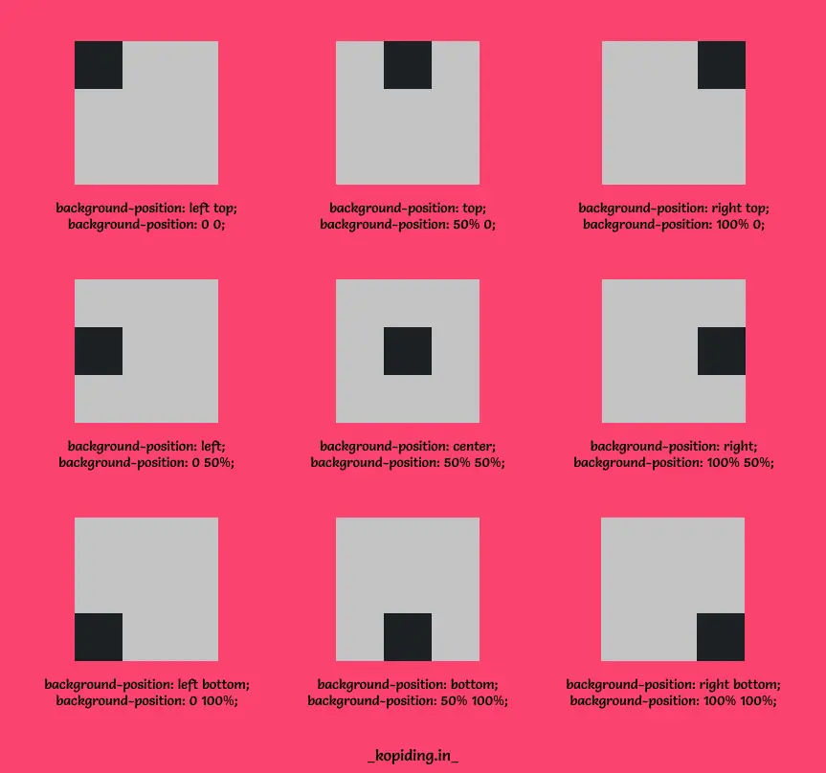

Slide 28
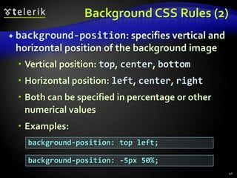

Slide 29
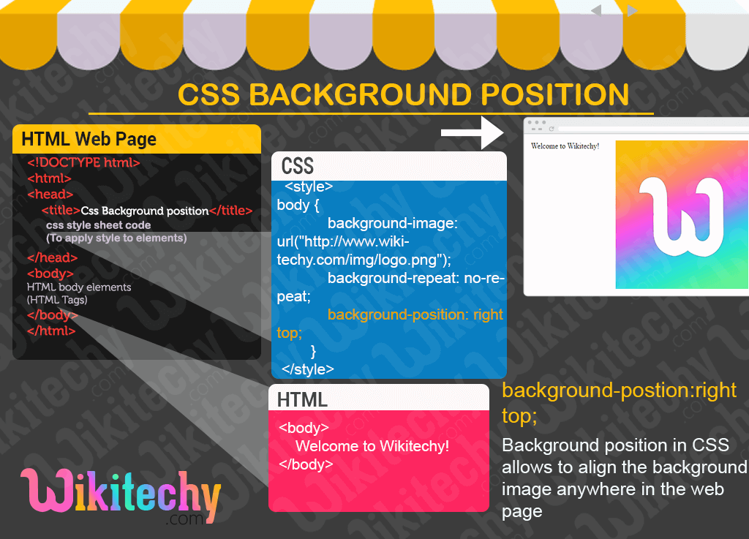

Slide 30

EXERCISES
1.Create a ordered list of your own in such a way that there are atleast 10 list items and bring the same output in unordered list as well.
2.Create the above lists using list-style-type,list-style-position.
3.Create the list using list-style-image.
4.Set the background image as cover.
5.Set the background image as contain.
6.Set the background image using no-repeat.
7.Bring the repeated images along the x-axis.
8.Bring the repeated images along the y-axis.
9.Bring the background image using auto.
10.Place an image at the center of a webpage.
11.Place an image at the top of a webpage.
12. Place an image at the bottom of a webpage.
13.Using percentage bring the image to left bottom.
14.Using percentage bring the image to right bottom.
15.Using percentage bring the image to right top.

Slide 31



Thank You

